Slide 1


Express-like routing with Gorilla
&y Haskell

Slide 2
About me
Andrew “&y” Haskell
Tufts University Class of 2013 (Computer Science and Biology double major)
MIT software engineer
You can find me on Twitter at @AndyHaskell2013

Slide 3

About me
I also write the blog Computer Science for the Slothful (csfortheslothful.blogspot.com).
So be warned, this presentation has sloths!

Slide 4
What is Gorilla?
A toolkit of useful web libraries like:
HTTP Routers
Sessions
Cookies
WebSockets
NOT A FRAMEWORK!

Slide 5
Gorilla mux
A router with an Express-like feel
Lets us:
Use URL parameters
Use regular expression matching
Limit routes to certain HTTP verbs
Still feels like working with net/http!

Slide 6
Making our router
Express
Gorilla
var app = express()
app.listen(1123)
r := mux.NewRouter()
http.Handle(“/”, r)
http.ListenAndServe(“:1123”, nil)

Slide 7
Adding basic routes
Express
Gorilla
app.use(‘/sloths’, function(req, res){
res.send(‘Sloths rule!’)
})
r.HandleFunc(“/sloths”, func(w http.ResponseWriter, r *http.Request){
fmt.Fprintf(w, “Sloths rule!”)
})

Slide 8
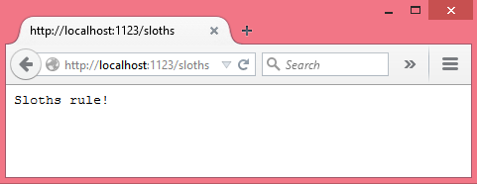
localhost:1123/sloths

Slide 9
Adding route prefixes
A plain Gorilla path only matches that exact path.
To match path prefixes we use PathPrefix.
serveSloths := func(w http.ResponseWriter, r *http.Request){
fmt.Fprintf(w, “Sloths rule!”)
}
serveHello := func(w http.ResponseWriter, r *http.Request){
fmt.Fprintf(w, “Hello world!”)
}
r.PathPrefix(“/sloths/”).HandlerFunc(serveSloths)
r.PathPrefix(“/”).HandlerFunc(serveHello)

Slide 10
Static file servers
In Express we can use the serve-static middleware
app.use(‘/images’,
express.static(__dirname + ‘/public/images’))

Slide 11
Static file servers
net/http has FileServer so we can use that
as a Handler in Gorilla!
r.PathPrefix(“/images/”).Handler(
http.StripPrefix(“/images/”,
http.FileServer(http.Dir(“public/images”))))

Slide 12
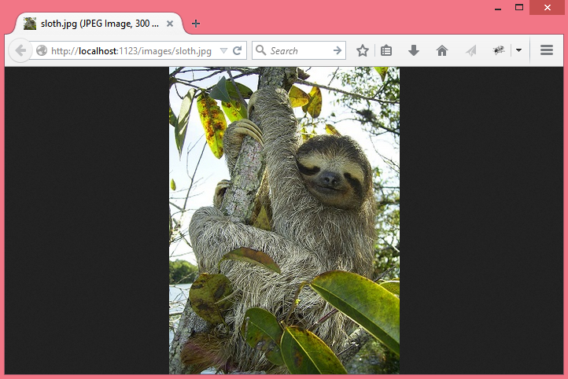
localhost:1123/images/sloth.jpg

Slide 13
URL parameters
In Express, we use colons for our URL parameters,
which are stored in req.params
app.use(‘/tea/:flavor’, function(req, res){
var tea = req.params.flavor + ‘ tea’
var html = ‘<img src=“/images/sloth.jpg”><br />’ +
‘<h2>I could use some’ + htmlEscape(tea) + ‘!</h2>’
res.send(html)
})

Slide 14
URL parameters
In Gorilla, we use braces for our URL parameters,
which we get by passing the request to mux.Vars.
r.HandleFunc(“/tea/{flavor}”,
func(w http.ResponseWriter, r *http.Request){
params := mux.Vars(r)
tea := html.EscapeString(params[“flavor”]) + “ tea”
html := `<body><img src=“/images/sloth.jpg” /><br />
<h2>I could use some ` + tea + `!</h2></body>`
fmt.Fprintf(w, html)
})

Slide 15
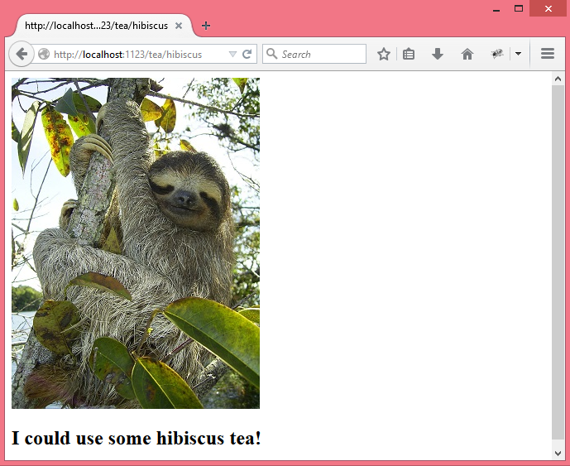
localhost:1123/tea/hibiscus

Slide 16
Regular expression routes
In Express, we can make routes with RegExps instead of strings
app.use(/\/(coffee)+/, function(req, res){
var html = ‘<img src=“/images/lemur.jpg”><br />’ +
‘<h2>Lemurs = sloths that had too much coffee!<h2>’
res.send(html)
})

Slide 17
Regular expression routes
In Gorilla, we just put the regular expression inside a URL parameter
r.HandleFunc(`/{drink:(coffee)+}`,
func(w http.ResponseWriter, r *http.Request){
html := `<body><img src=“/images/lemur.jpg”><br />
<h2>Lemurs = sloths that had too much coffee!
</h2></body>`
fmt.Fprintf(w, html)
})

Slide 18
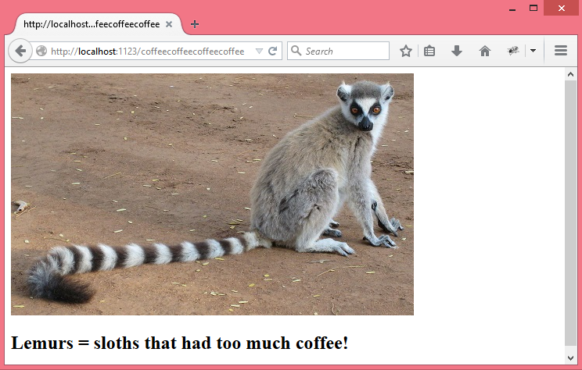
localhost:1123/coffeecoffeecoffeecoffee

Slide 19
Routes by HTTP verb
In Express, we use app.get, app.post, etc.
The HTML for a coffee shop order form
app.get(‘/coffee-shop’, function(req, res){
res.send(‘<form action=“/order” method=“POST”>’+
‘Your name <input type=“text” name=“name” /><br/ >’+
‘Your beverage order ’ +
‘<input type=“text” name=“beverage” /><br/ >’+
‘<input type=“submit” value=“Submit”/>’+
‘</form>’);
});

Slide 20
Routes by HTTP verb
And we can parse POST data with body-parser
The response to your order, “One [beverage] coming right up, [name]!”
app.post('/order', bodyParser.urlencoded({extended:true}),
function(req, res){
var name = htmlEscape(req.body.name),
beverage = htmlEscape(req.body.beverage);
res.send('<h1>One '+ beverage + ' coming right up ' +
name + '!</h1>');
});

Slide 21
Routes by HTTP verb
In Gorilla, we specify HTTP verbs with .Methods
r.HandleFunc(“/coffee-shop”, func(w http.ResponseWriter, r *http.Request){
html := `<body><form action=“order” method=“POST”>
Your name <input type=“text” name=“name”><br />
Your beverage order
<input type=“text” name=“beverage”><br />
<input type=“submit” value=“Submit”>
</form></body>`
fmt.Fprintf(w, html)
}).Methods(“GET”)

Slide 22
Routes by HTTP verb
And we parse POST data with Request.ParseForm
r.HandleFunc(“/order”, func(w http.ResponseWriter, r *http.Request){
err := r.ParseForm()
if err != nil {
log.Fatal(err.Error())
}
name := html.EscapeString(r.Form.Get(“name”))
beverage := html.EscapeString(r.Form.Get(“beverage”))
html := `<body><h1>One ` + beverage +
` coming right up, ` + name + `!</h1></body>`
fmt.Fprintf(w, html)
}).Methods(“POST”)

Slide 23
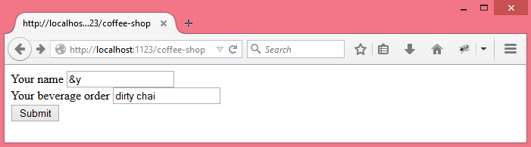
localhost:1123/coffee-shop

Slide 24
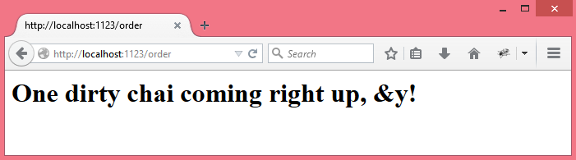
Submitting the form

Slide 25
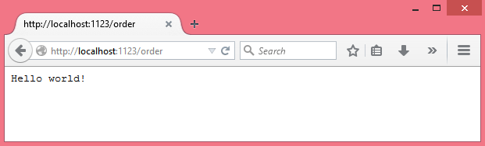
Trying to GET request localhost:1123/order

Slide 26
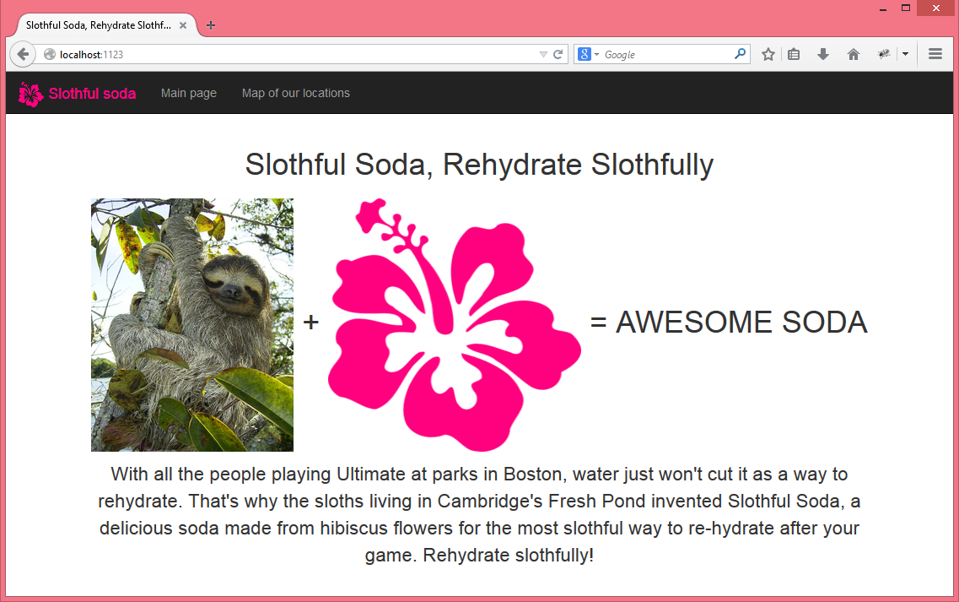
If you want a flashier example
Check out my tutorial “Try Web Development in Go with Slothful Soda” on csfortheslothful.blogspot.com!

Slide 27
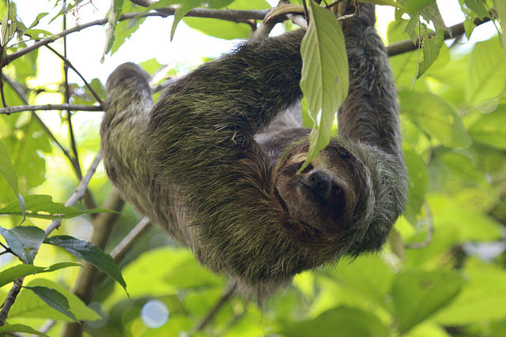
Thanks for listening! Stay slothful!

Slide 28
Image credits
The Go Gopher mascot was made by Renee French.
The Gorilla mascot was made by Martin Bérubé
The author of the picture of the sloth in the examples is Stefan Laube and the picture is public domain.
The author of the picture of the lemur in the examples is Alex Dunkel and the picture is licensed under CC BY 3.0.
The author of the picture of the sloth at the end of the tutorial is Roy Luck and the picture is licensed under CC BY 2.0.

